Slide 1
Computer Architecture and Organization

Slide 2
Definition
In general terms, the architecture of a computer system can be considered as a catalogue of tools or attributes that are visible to the user such as instruction sets, number of bits used for data, addressing techniques, etc.
Whereas, Organization of a computer system defines the way system is structured so that all those catalogued tools can be used. The significant components of Computer organization are ALU, CPU, memory and memory organization.

Slide 3
Computer Architecture | Computer Organization
Computer Architecture is concerned with the way hardware components are connected together to form a computer system. | Computer Organization is concerned with the structure and behaviour of a computer system as seen by the user.
It acts as the interface between hardware and software. | It deals with the components of a connection in a system.
Computer Architecture helps us to understand the functionalities of a system. | Computer Organization tells us how exactly all the units in the system are arranged and interconnected.
A programmer can view architecture in terms of instructions, addressing modes and registers. | Whereas Organization expresses the realization of architecture.
While designing a computer system architecture is considered first. | An organization is done on the basis of architecture.
Computer Architecture deals with high-level design issues. | Computer Organization deals with low-level design issues.
Architecture involves Logic (Instruction sets, Addressing modes, Data types, Cache optimization) | Organization involves Physical Components (Circuit design, Adders, Signals, Peripherals)

Slide 4
Instruction Codes in Computer Architecture
A computer instruction is a binary code that specifies a sequence of microoperations for the computer. The instruction code with the data stored in memory.
Generally, we can categorize instruction codes and addresses into operation codes(Opcodes) and addresses. Opcodes specify how to perform a specific instruction. An address specifies which we should use- a register or an area, for a particular action. Operands are precise computer instructions that show what information the computer requires to function.

Slide 5
What is the Instruction Code?
Instruction codes are bits that instruct the computer to execute a specific operation. An instruction comprises groups called fields. These fields include:
An instruction comprises groups called fields. These fields include:
The Operation code (Opcode) field determines the process that needs to perform.
The Address field contains the operand's location, i.e., register or memory location.

Slide 6
OPCODE
The Opcode define operations such as add, subtract, etc.
The Opcode must consist with n bits for a given 2^n distinct operation.
When this operation code is decoded in the control unit the computer issues signals to read an operand from memory and add the operand to processor register.

Slide 7
Stored Program Organization

Slide 8

Structure of an Instruction Code

Slide 9
Indirect Addressing

Slide 10
Lecture-Register

Slide 11
Computer Registers
Computer instructions are normally stored in consecutive memory locations and are executed sequentially one at a time.
The instruction sequencing need a counter to calculate the address of the next instruction after execution of the current instruction is completed.
The computer needs processor of registers for manipulating data and a register for holding a memory address.

Slide 12
List of Registers

Slide 13
Program Counter
The AR register is 12 bit which is width of the memory address.
The PC register also 12 bit and it hold the address of next instruction.
The PC goes through a counting sequence until branch encountered.
The address part of the branch is transferred into PC.

Slide 14
Common Bus System
The basic computer has eight registers, a memory unit, and a control unit.
A efficient way to transfer information in between these registers is to use common bus system.
The output of seven registers and memory are connected to the common bus.
The selection lines are used to select register that can use bus.
The register whose LD(load) input is enable receive the data from the bus.

Slide 15
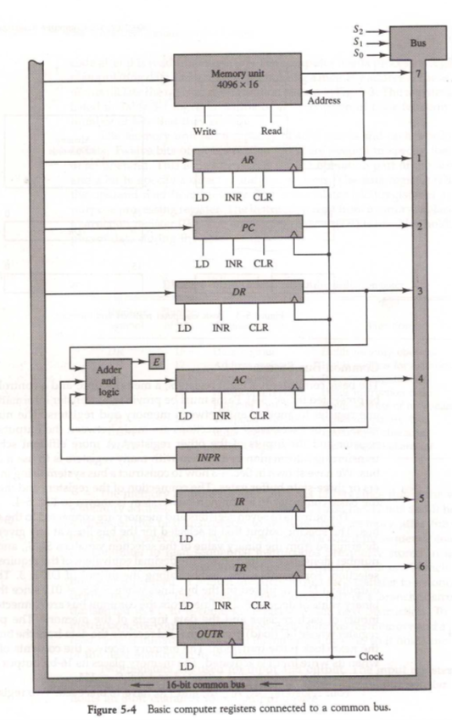
Common Bus System
Four Registers DR, AC, IR and TR have 16 bits each.
AR and PC are 12 bit registers.
When AR and PC use bus the first 4 MSB are set to 0.
The INPR and OUTR have 8 bits each and communicate with the eight LSB in the bus.

Slide 16
Common Bus System
The 16 bit of bus receive information from six registers and the memory.
5 registers have three control inputs LD, INR and CLR.
INPR receive character from the input device and transferred to AC.
OUTR receive character from the AC and deliver it to an output device.

Slide 18
The instruction code is also known as an instruction set. It is a collection of binary codes. It represents the operations that a computer processor can perform. The structure of an instruction code can vary. It depends on the architecture of the processor but generally consists of the following parts:
Opcode: The opcode (Operation code) represents the operation that the processor must perform. It might indicate that the instruction is an arithmetic operation such as addition, subtraction, multiplication, or division.
Operand(s): The operand(s) represents the data that the operation must be performed on. This data can take various forms, depending on the processor's architecture. It might be a register containing a value, a memory address pointing to a location in memory where the data is stored, or a constant value embedded within the instruction itself.
Addressing mode: The addressing mode represents how the operand(s) can be interpreted. It might indicate that the operand is a direct address in memory, an indirect address (i.e. a memory address stored in a register), or an immediate value (i.e. a constant embedded within the instruction).
Prefixes or modifiers: Some instruction sets may include additional prefixes or modifiers that modify the behavior of the instruction. For example, they may specify that the operation should be performed only if a specific condition is met or that the instruction should be executed repeatedly until a specific condition is met.

Slide 19
Types of Instruction Code
There are various types of instruction codes. They are classified based on the number of operands, the type of operation performed, and the addressing modes used. The following are some common types of instruction codes:
One-operand instructions: These instructions have one operand and perform an operation on that operand. For example, the "neg" instruction in the x86 assembly language negates the value of a single operand.
Two-operand instructions: These instructions have two operands and perform an operation involving both. For example, the "add" instruction in x86 assembly language adds two operands together

Slide 20
Three-operand instructions: These instructions have three operands and perform an operation that involves all three operands. For example, the "fma" (fused multiply-add) instruction in some processors multiplies two operands together, adds a third operand, and stores the result in a fourth operand.
Data transfer instructions: These instructions move data between memory and registers or between registers. For example, the "mov" instruction in the x86 assembly language moves data from one location to another.

Slide 21
Control transfer instructions: These instructions change the flow of program execution by modifying the program counter. For example, the "jmp" instruction in the x86 assembly language jumps to a different location in the program.
Arithmetic instructions: These instructions perform mathematical operations on operands. For example, the "add" instruction in x86 assembly language adds two operands together.
Logical instructions: These instructions perform logical operations on operands. For example, the "and" instruction in x86 assembly language performs a bitwise AND operation on two operands.

Slide 22
Comparison instructions: These instructions compare two operands and set a flag based on the result. For example, the "cmp" instruction in x86 assembly language compares two operands and sets a flag indicating whether they are equal, greater than, or less than.
Floating-point instructions: These instructions perform arithmetic and other operations on floating-point numbers. For example, the "fadd" instruction in the x86 assembly language adds two floating-point numbers together.

Slide 23
Opcodes
An opcode is a collection of bits representing the basic operations, including add, subtract, multiply, complement, and shift. The number of bits required for the opcode is determined by the number of functions the computer gives. For ‘2n’ operations, the minimum bits accessible to the opcode should be ‘n’, where n is the number of bits. We implement these operations on information saved in processor registers or memory.

Slide 24
Types of Opcodes
There are three different types of instruction codes on the main computer. The instruction's operation code (opcode) is 3 bits long, and the remaining 13 bits are determined by the operation code encountered.
There are three types of formats:
Memory Reference Instruction: It specifies the address with 12 bits and the addressing mode with 1 bit (I). For direct addresses, I equal 0, while for indirect addresses, I equal 1.

Slide 25
Register Reference Instruction: The opcode 111 with a 0 in the leftmost bit of the instruction recognizes these instructions. The remaining 12 bits specify the procedure to be carried out
Input-Output Instruction: The operation code 111 with a 1 in the leftmost bit of instruction recognizes these instructions. The input-output action is specified using the remaining 12 bits.

